Slide 1

Who am I?
Brandon Lobb
Viasat’s University Relations and Recruitment team
5 years in the recruitment field
2 years as a HS Teacher with Teach For America
San Diego State – BA.
University of Nevada, Las Vegas – M.Ed

Slide 2



Viasat: Overview

Slide 3


Slide 4


Half of the world has no internet access. Let’s change that.

Slide 5
At a glance
1986
year founded
28
offices around the globe
4
satellites in orbit
5,200+
team members
$1.6B
in annual sales*
$4.6B
enterprise value
United States:
Carlsbad, CA (HQ)
Atlanta, GA
Austin, TX
Baltimore, MD
Boston, MA
Bryan/College Station, TX
Cleveland, OH
Denver, CO
Germantown, MD
Marlborough, MA
San Jose, CA
Seattle, WA
Spring Lake, NC
Tampa, FL
Tempe, AZ
Washington, DC
Australia:
Canberra
Melbourne
Sydney
China: Beijing
India: Chennai
Ireland: Dublin
Israel: Tel Aviv
Netherlands: Amsterdam
Switzerland: Lausanne
UK: Farnborough
* FY17, ended March 31, 2017
* FY18, ended March 31, 2018

Slide 6




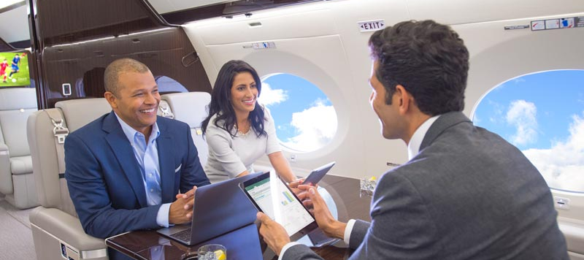

Fast connections for consumers and businesses
Unlimited home internet plans mean
unlimited possibilities
Business internet and Wi-Fi for
hard-to-serve locations
Connecting the unconnected to
affordable high-speed internet
The best Wi-Fi in the sky gives every passenger freedom to stream
Stay productive and entertained
on private aircraft
Fast, reliable internet for cruise ships, pleasure craft, and other vessels

Slide 7



ViaSat-3: game-changing innovation
Expected to be the most cost-efficient, integrated, flexible, global satellite broadband infrastructure
Expected capacity
1+ Tbps per satellite
Global constellation
Americas and EMEA underway
Construction start
December 2015¹
Anticipated launch
Late 2019 / early 2020²
Expected design life
~15 years
Efficient asset
Expected to be ~3-4x more cost efficient than VS-2
(1) Americas and EMEA. (2) First ViaSat-3 class satellite

Slide 8


How to Navigate an Offer

Slide 9

You’ve got job offers, great job!

Slide 10
Understanding the Offer Stage!
Create a Better Understanding of
“The Offer Package”
Think About What’s Important to You!
Accepting the Offer, What Happens Next?
Define and Describe Compensation and Benefits

Slide 11


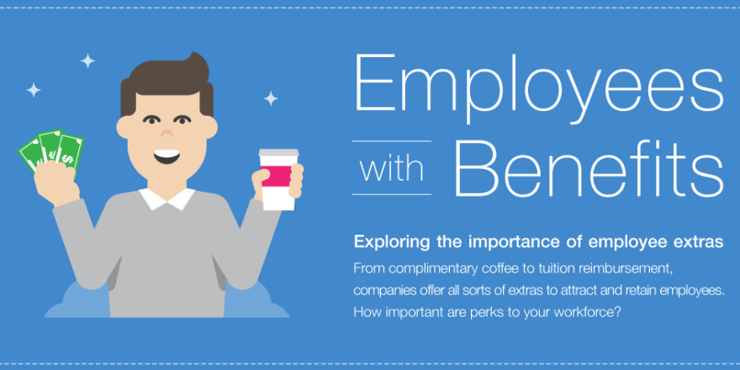
Compensation
The money received by an employee from an employer as salary or wages for the cost of labor or work performed.
Types of Compensation
Direct Forms of Compensation
Indirect Forms of Compensation

Slide 12
Factors in Determining Compensation
Performance
Leadership
Unique Capabilities
Impact to Viasat
Skill Scarcity
Responsibilities
Internal Equity
External Market
Employee Compensation
Notes:
How employers decide on an offer

Slide 13
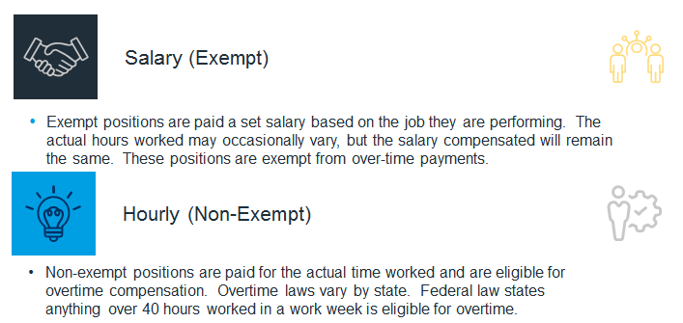

Direct Forms of Compensation

Slide 14
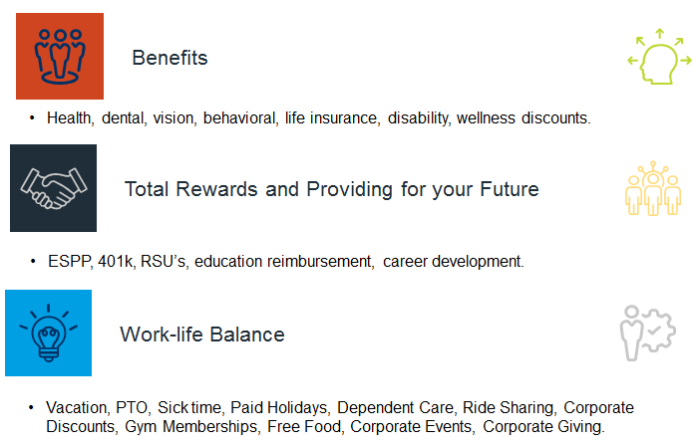

Indirect Forms of Compensation

Slide 15
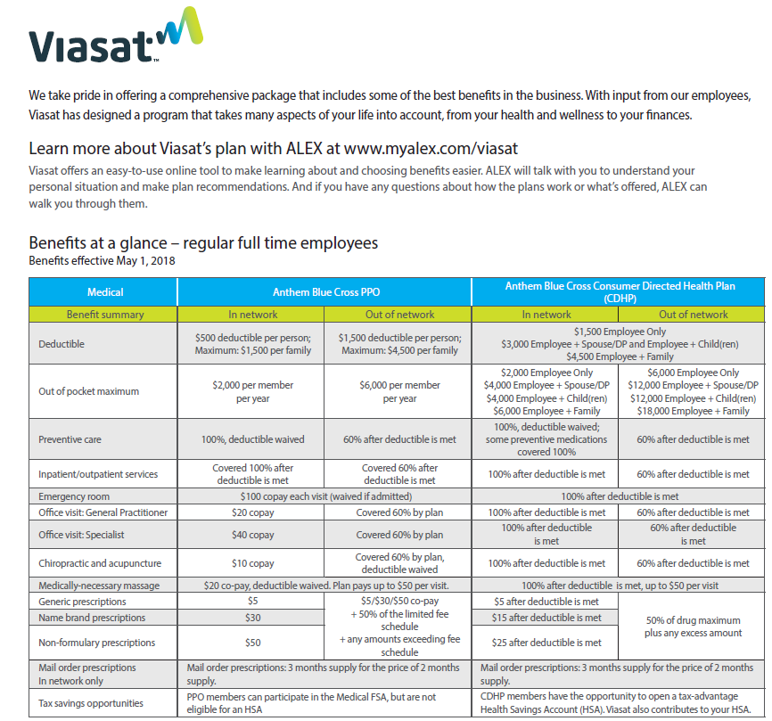
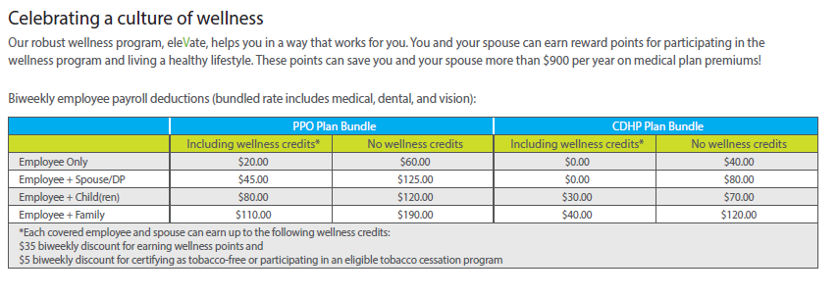
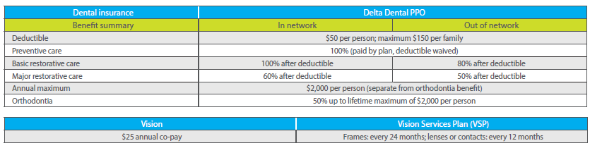
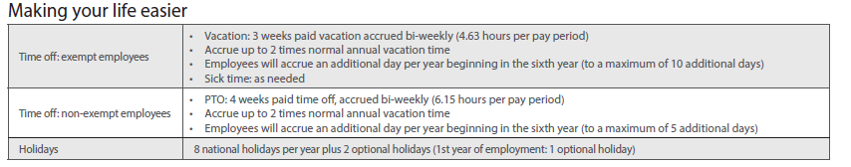
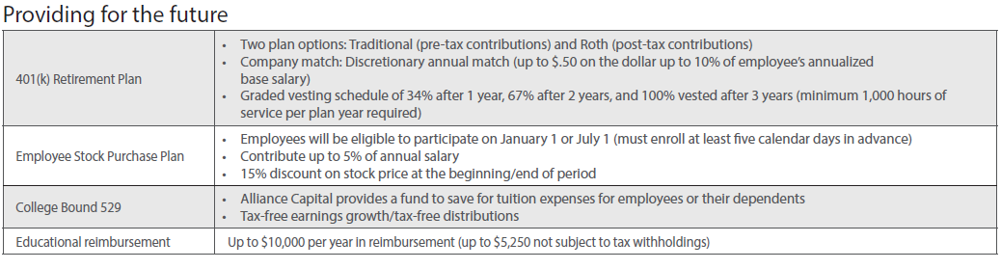
Benefits at a Glance

Slide 16

What’s Important to You?
Think About the Full Package - Quality of Work Life, Benefits, Culture…. in addition to the Money!
Think about what you want?
What motivates you personally and professionally?
Consider who you’ll be working with.
Think long and short term. It’s your future!
Give yourself enough time to think about your decision.
Location, where do you want to be and why?
Company Culture is more important than you think!
Happiness is Priceless!

Slide 17
Reviewing your Offer… things to think about
Think about what you want from this opportunity:
  What motivates you personally and professionally?
  Fulfillment from the impact of your work?
  Career growth opportunities?
Name brand recognition on your resume?
Think about the full package not just the money.
Keep in mind this is short-term and long-term!
Give yourself enough time to think about your decision.
Company culture is incredibly important!

Slide 18

The Negotiating Checklist
Know the salary range – you can ask this!
Put your number out first, as this acts like an “anchor”.
Be realistic during the negotiation process.
Back up your request with your experience and performance.
Be willing to compromise and learn about compensation opportunities after hire.

Slide 19

Be Aware: Facts
Drinking caffeine makes you more resistant to persuasion, allowing you to stand your ground.
Asking for a specific number improves your chances for success.
20% of candidates never negotiate salary during the interview process.
59% say that they dread negotiating – it makes them nervous.
Only 38% of millennials negotiate their offers compared to 48% of Boomers and 46% of Gen X.
The average raise in corporate America is 3-5% – ask now!

Slide 20
What to Say and What Not to Say
DO
Discuss your experience.
Discuss your performance in similar positions.
Explain why you deserve the top pay range.
Say you are option to stock and bonus options.
Stick with an exact number.
Don’t be afraid to counter their offer!
Use positive language rather than negative.
Be aware of your tone and body language.
DON’T
Say you will walk away unless your demand is met.
“Your job description was misleading”.
Threaten the other party.
Come across boastful about your skillset, self, etc.
Disclose your current salary.
Apologize for negotiating
“I know someone that works here and makes X”.

Slide 21

Common Mistakes
Having unreasonable asks in your counter.
Negotiating without providing the value that you offer.
Not being prepared going into the negotiating process – take some time!
Accepting the job offer before you work out salary details, and keeping the numbers low.
Asking for too much when making a counter offer.

Slide 22
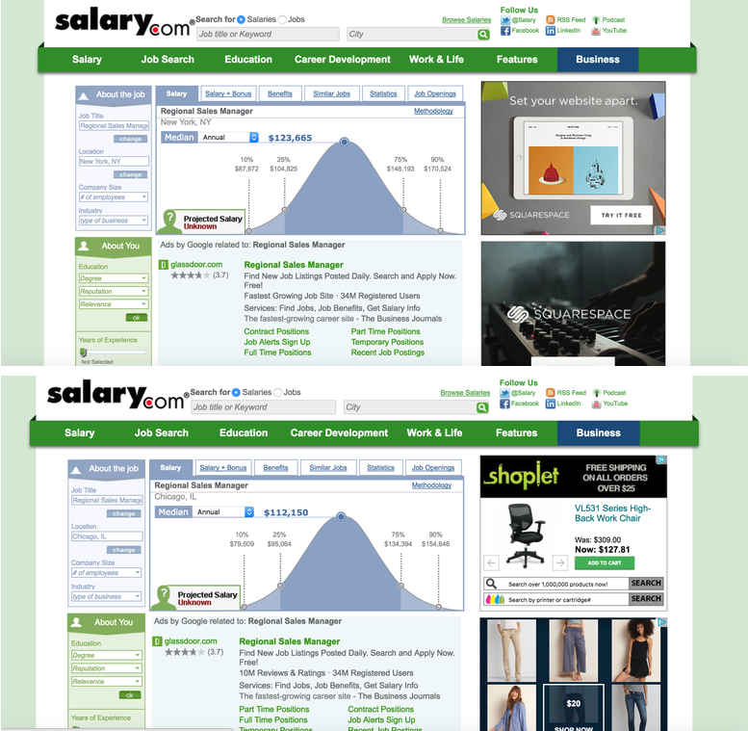
Resources
Avoid Glassdoor for salary information – only provides wide ranges.
Instead use:
  Salary.com
    Details by location, job title, education level, etc.
  PayScale.com
    Customize to see your worth in an industry
  Indeed.com
    Shows salary ranges and specifics for posted roles.
  SalaryExpert.com
    Customized to your qualifications and shows averages

Slide 23
Examples
If they ask how much you make or want to make:
“I’d love to give you a figure, but I was wondering if you’d be able to share your budget for this role. I don’t want to go in too high and I would love to get to a figure that would work for both of us.”
“According to my research, a day rate for a role like this is anywhere between [X number and Y number]. Because of my experience in [X industry], I’d be looking for the higher end of that scale.” Then share examples of why the top rate is best for you.
Setting up the meeting:
  “I would like to schedule a time to discuss my offer and see if we can discuss the flexibility of my salary.”
The pitch:
  "I definitely understand budgeting issues, and I want to be as flexible as possible to work with your team. I'm still very excited about joining your group, and would like to explore whether $60,000 is possible given my specific experience and skill set.”
When they put the nail in the coffin and say ‘no’:
  "OK, I'm not sure whether this is going to work with our budget, but let me look into it. We'll get back to you with an answer by tomorrow."
  Stay calm, cool and confident, and reply with something simple like, "Thank you, I really appreciate your help with that."

Slide 24

Quick Reminders!
THANK YOU!
“I am excited about the opportunity to work together”.
Research
Take a few days
Market value and your value
Follow-up

Slide 25

Questions

