Slide 1

Networking and Making Industry Connections
Leveraging all channels and connections to get the job!
Tod A Pascal & Zheng Chen
Nanoengineering, UCSD

Slide 2
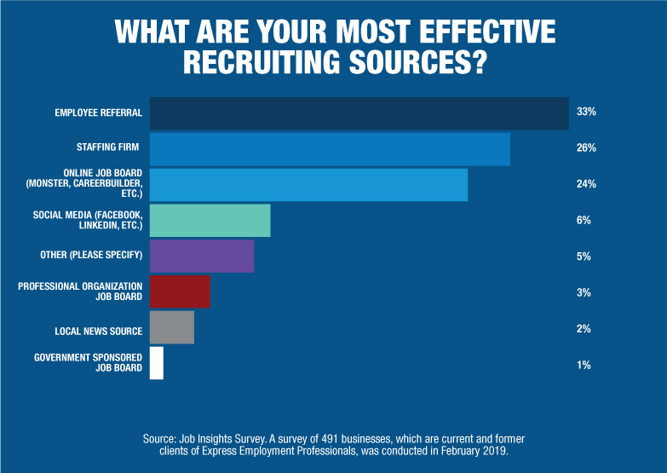
Right connections = 3 – 10x better odds

Slide 3
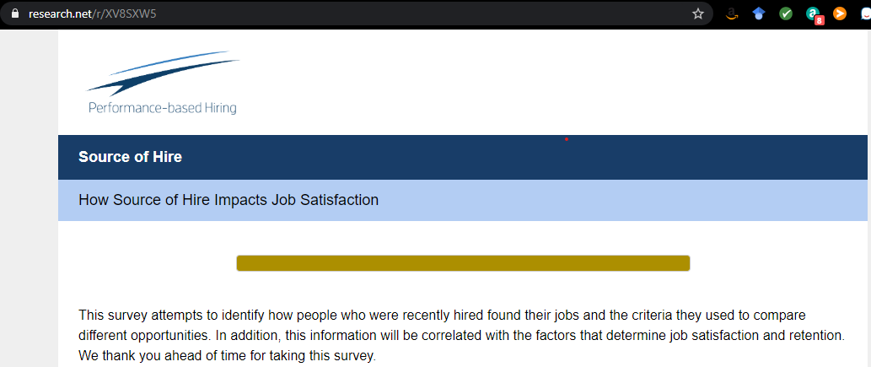
Right connections = 3 – 10x better odds

Slide 4
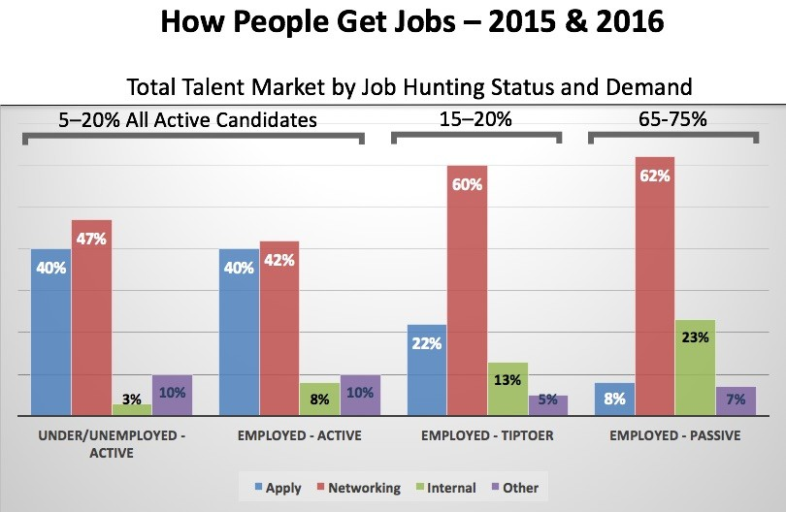
Right connections = 3 – 10x better odds

Slide 5
Take home messages:
Use the backdoor to gain access to the “hidden” job market
Leverage your social networks: more than just databases, they are essential tools for developing stronger connections
  “Job seekers need to realize networking is not trying to meet as many people as possible. It’s about meeting a few well-connected people who can vouch for your ability and who are willing to refer you to a few other well-connected people.”
Be yourself, be dynamics, be different!

Slide 6
Networking 101
“You already know how to network.”
Start with your inner circle
  Don’t be all about business. Foster meaningful relationships.
  Make conversations about them, not yourself.
  Know your boundaries. Never hard sell.
  Try to understand their problems first. You’ll learn something valuable and it’ll pay off later.

Slide 7
Networking 101
“Never assume their time or advice comes free of charge.”
Begin with people you already know
  You don’t need to meet new people to start networking effectively
  New grads: start with friends and family
  Find your university’s alumni database and look for people in your field
  Don’t forget about people who have given you guidance before

Slide 8
Networking 101
“…they already know you and trust you.”
When approaching someone new, find a way to help them first
  Never assume that their time or advice comes free of charge
  Research the company/person you’re approaching and find something small to contribute
  Most importantly: do it without expecting anything in return
    If you get rejected anyway, don’t show disappointment
  once you’ve established a new contact by providing something valuable, don’t ask for a favor straight away

Slide 9
Networking 101
“…the key is to maintain a lasting relationship.”
Follow up. Don’t let your relationships collect dust
  Keep your relationships alive by reaching out to your contacts regularly
    Once you disappear off their radar, you’ll have to start again from scratch
    always follow up on your previous meetings and emails
    Never forget to thank them for their help or advice
  Reaffirm your intention to follow through and thank them specifically for anything they have offered to do

Slide 10
Networking 101
“…lasting relationship are not only transactional, there are trusted.”
Never ask for a job directly
  Ask for advice and information instead
    You don’t put them in an awkward position
    You don’t look like you want others to solve your problems for you
    They’ll get to know you better

Slide 11
Networking 101
Networking is not about just about getting what you want
“You already know how to network.”
“Never assume their time or advice comes free of charge.”
“…they already know you and trust you.”
“…the key is to maintain a lasting relationship.”
“…lasting relationship are not only transactional, there are trusted.”

Slide 12
Some useful tips:

Slide 13

1. Networking on Social Media
Sometimes it can be much easier to reach out to people online.
The first step is identifying some industry people you’d like to connect with.
Don’t just pick names out of a hat – choose people who work in a field you’re interested in.
Next, you’ll want to start engaging with them on Twitter, Facebook, YouTube, or their blog.
The Art of Networking: 5 steps to making better music industry connections, by Dave Kusek of New Artist Model.

Slide 14
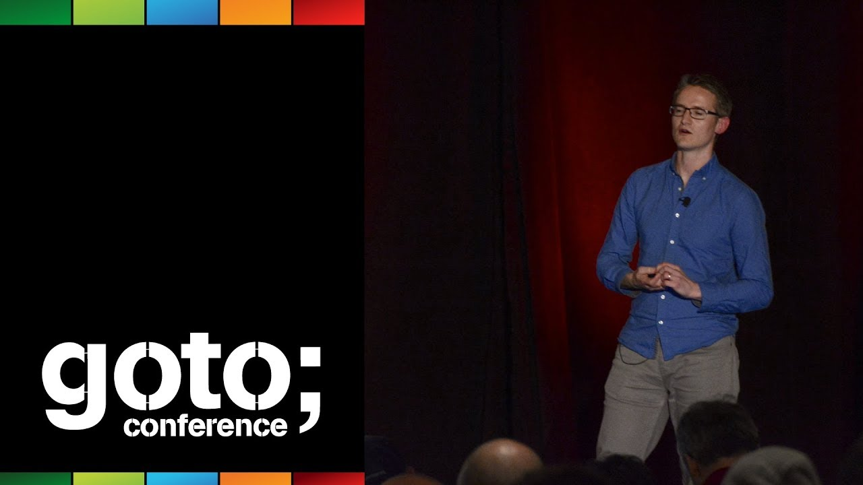
2. Get Out There! Try to meet face-to-face
Networking and connecting on social media is something you should be constantly doing
Talking face-to-face is probably the best way to connect with people
Go to conferences, workshops, festivals, and concerts. Attend as many as possible (financial constraints)
Be prepared.

Slide 15
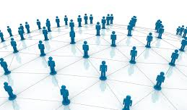

3. Every Conversation is a Networking Opportunity
Don’t dismiss any conversation and always be prepared with a business card (if you have) with contact information (and your website, if you have);
Not every connection will lead to opportunities;
Many of the opportunities may fall through, but if you don’t make the initial connection you won’t get any opportunities.

Slide 16
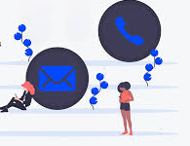
4. Follow up! Keep connected.
Try to get some form of contact information and take the initiative to follow up.
No matter how good people’s intentions may be, sometimes they just forget to follow through. It’s up to you to rekindle the conversation!
Jot down or make a note in your phone the date and location you met the person and what you discussed. Including little details like this in your follow up will show them that you really care about what they had to say.
Don't be afraid follow up on your initial contact if you haven't heard back in a reasonable amount of time. Often people will appreciate the effort to connect with them

Slide 17
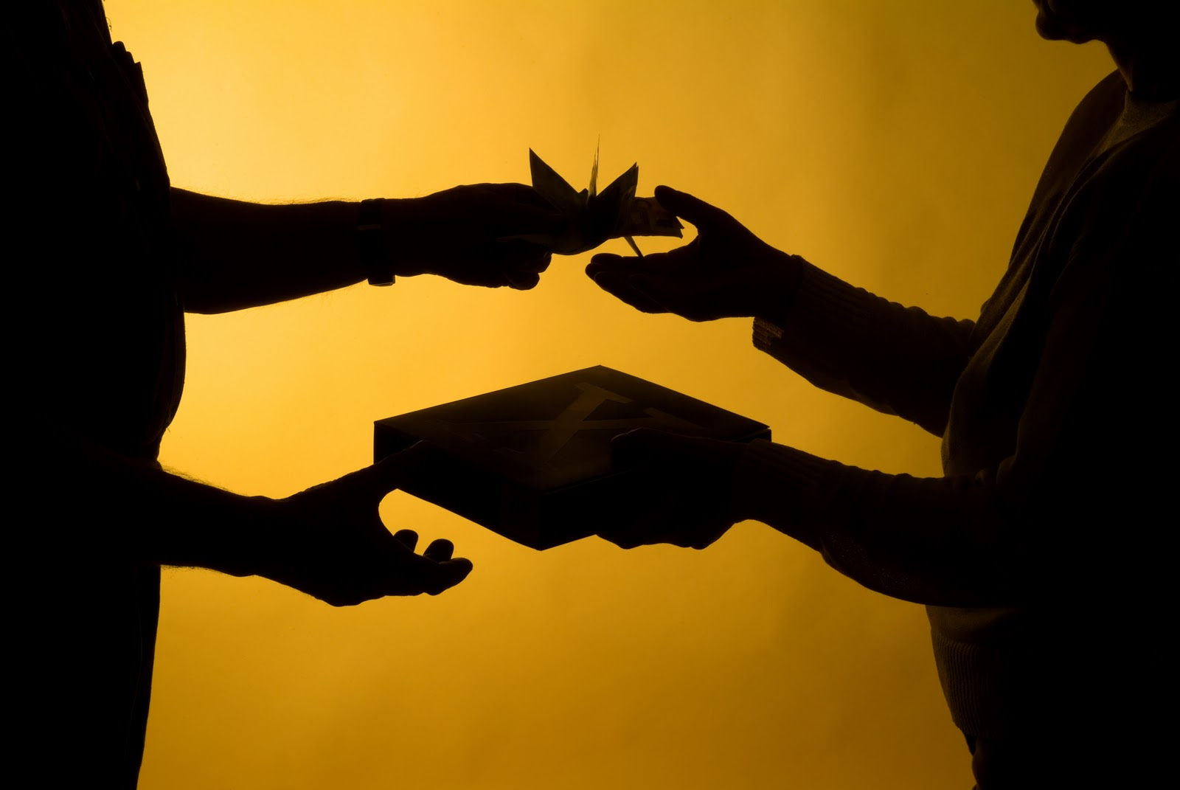
5. Give and Receive.
Any industry is about forming mutually beneficial long-term relationships, and relationships are as much about giving as they are receiving.
Every time you meet someone, think about what you can do to help them before jumping in and asking favors.
Opportunities and relationships that are built on a mutual benefit also tend to last longer.

Slide 18

Use Your Referrals
Best friends
Advisors/mentors
Colleagues
Alumni
…

Slide 19

Setting up introductions for others
Elevate yourself from “desperate PhD” to super-connector and potential colleague.
If you’re a functioning PhD with any transferable skills whatsoever, you felt a sense of gratefulness towards the person who introduced you.
You can do it to establish new connections for yourself.
You saw the introducer as a leader, as someone who was well-connected, selfless, and overall—a giver.

Slide 20
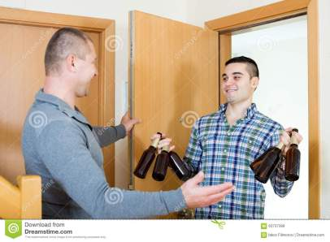
Ways to maintain the Connection/Relationship
Again, follow-up
Share news, progress, position/life changes
Birthdays (if you know), big dates, holiday greetings
Sending cards (can be e-card)
Arrange a meeting/visit if there is a trip.

Slide 21
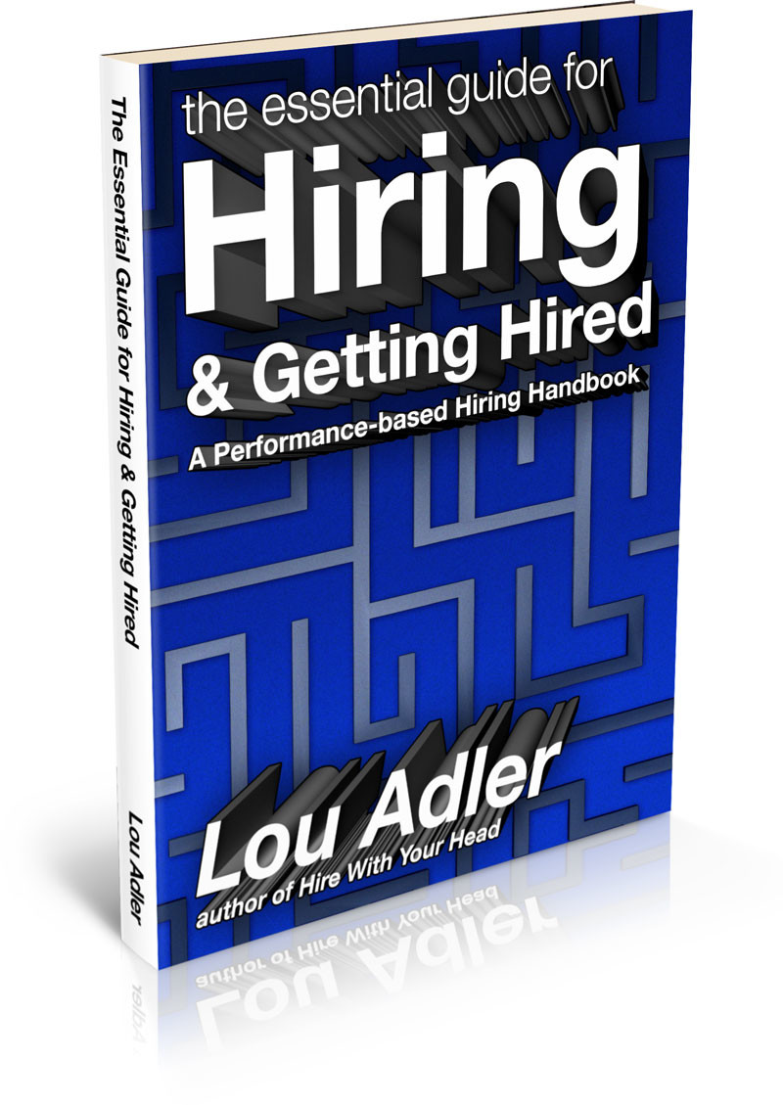
Further reading

