Slide 1


How to Give a Good Presentation
Zheng Chen, Tod Pascal
Email: zhengchen@eng.ucsd.edu; tpascal@eng.ucsd.edu
April 10, 2020

Slide 2
Overview
“I got 1 word for you, just one word: Practice!”
“On March 21, 1949, I attended a lecture given by Linus Pauling.... That talk was the best talk by anyone on any subject that I had ever heard…. The talk was more than a talk to me. It filled me with a desire of my own to become a speaker.”
Isaac Asimov, Foreword to Linus Pauling: A Man and His Science, Anthony Serafini (San Jose: to Excel, 2000), p. xiv
“the microphone was erratic, Bohr’s aspirated and sibilant diction mostly incomprehensible, and his thoughts too intricately evolved even for those who could hear.”
-- D.H. Frisch, private communication to Abraham Pais, “Reminiscences from the Postwar Years,” Niels Bohr: A Centenary Volume, ed. by A.P. French and P.J. Kennedy (Cambridge, MA: Harvard University Press, 1985), p. 247

Slide 3
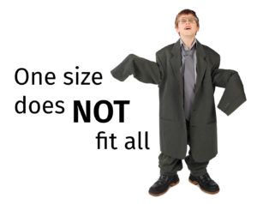
General Philosophy
There are as many styles for good presentations as there are for bad ones
Choose the style that best suits you and your personality
  Soft-spoken and Humble – Einstein
  Dynamic and Charismatic – Pauling
  Demonstrative and Humorous – Feynman
  Aspirational – Obama
  Direct and Conversational – Reagan

Slide 4
General Philosophy
Pro tips
  Prepare before hand
    Do not attempt to overwhelm the audience to cover up for not preparing/understanding the material
    A presentation that only serves to confuse or irritate the audience is a wasted opportunity
  Set appropriate expectations at the outset: “pre-condition” your audience (matrix)
  Say no to stock/canonical MS PowerPoint templates: you are not a robot! Take ownership of your presentation!
  Number of slides: Less is not more… but more is not better!

Slide 5
Before you present…
Keep in mind:
Giving scientific presentations is expensive!
  Time (most valuable and not renewable)
  Energy: both mental and emotional, for both audience and presenter
  Financial: travelling to conferences, registration fees..
  Recognition: being a bad/sub-optimal speaker may mean that someone else on the team will be chosen to present the work, which may then be perpetually associated with that person, even though they were not the main contributor

Slide 6
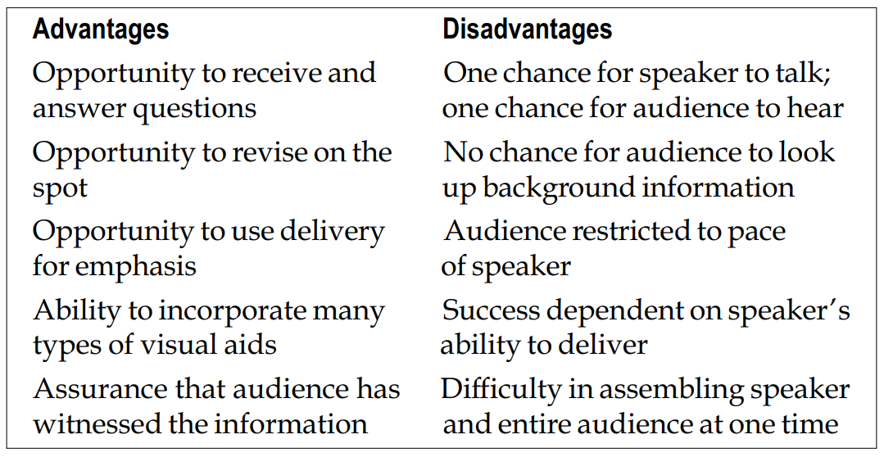
Before you present…

Slide 7
Perspectives on Presenting
Speech
A speech targeted to the audience is essential for a presentation’s success
Case study: Robert Oppenheimer
At 25 (and already famous for his work on Quantum Theory), he started lecturing at UC Berkeley
Halfway through the first semester, all but one of the students had dropped the class:
His pace was too fast for the students, although he thought he was going too slow
he made “obscure references to the classics of literature and philosophy.”
Failed to match what was said to the audience, purpose, and occasion

Slide 8
Perspectives on Presenting
Speech
A speech targeted to the audience is essential for a presentation’s success
Add some “flavor” to your speech
Incorporate analogies/examples. Remember, you are not just presenting data, you are telling a story
Make a personal connection. Especially if you are a nervous speaker, it might help to identify someone in the room and “talk to them”
Incorporate humor if you can: After being introduced as a theoritical physicist who “enjoys playing the bongo drum”, Feynman started off his talk by saying:
“It is odd, but on those infrequent occasions when I have been called upon in a formal place to play the bongo drums, the introducer never seems to find it necessary that I also do theoretical physics.”

Slide 9
General tips

Slide 10
1. Preparing A Good Slides: Impression Matters
A Clear/Clean Background
Use Large Font Size (> 24)
Be Organized and Neat
Do not Cram too Much
Use Color and Animation
Be Brief (use key words, not long sentences)
Be Clear in Figures (size and label)
Be Consistent (font, size, color, etc.)
One Slide, One Point

Slide 11
1.1 Use A Clear/Clean Background

Slide 12
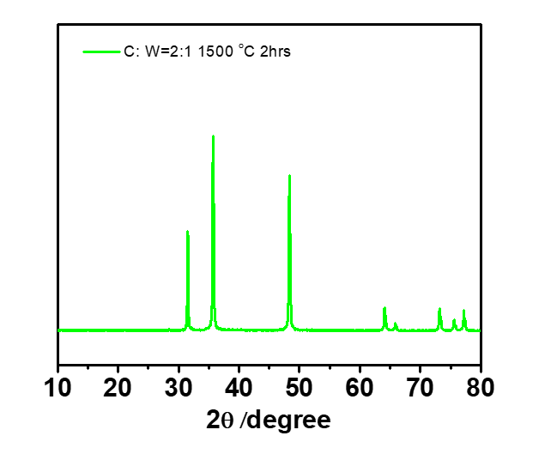
Study the Effect of Precursor Composition in XX Synthesis
Conditions 1: (Batch -1)
Carbon : XX ratio = 3:1 (in mass)
Conditions: 1500 deg C 4 hrs
Conditions 1: (Batch -2)
Carbon : XX ratio = 2:1 (in mass)
Conditions: 1500 deg C 2 hrs
Results(or findings):
New peak showing at xx deg;
Intensity changed at xx;
Mixed xx, yy
Note:
“Carbon” means phenolic resin as the carbon source
“xx” means yy as the Z source

Slide 13
Study the Effect of Precursor Composition in XX Synthesis
Conditions 1: (Batch -1)
Carbon : XX ratio = 3:1 (in mass)
Conditions: 1500 deg C 4 hrs
Conditions 1: (Batch -2)
Carbon : XX ratio = 2:1 (in mass)
Conditions: 1500 deg C 2 hrs
Results(or findings):
New peak showing at xx deg;
Intensity changed at xx;
Mixed xx, yy
Note:
“Carbon” means phenolic resin as the carbon source
“xx” means yy as the Z source

Slide 14
1.2 Use Large Font Size (> 24)

Slide 15
1.2 Use Large Font Size (> 24)
Conditions 1: (Batch -1)
Carbon : tungsten ratio = 3:1 (in mass)
Conditions: 1500 deg C 4 hrs
Conditions 1: (Batch -2)
Carbon : tungsten ratio = 2:1 (in mass)
Conditions: 1500 deg C 2 hrs

Slide 16
1.3 Be Organized and Neat

Slide 17
1C = 166.3 mA h/g

Slide 18
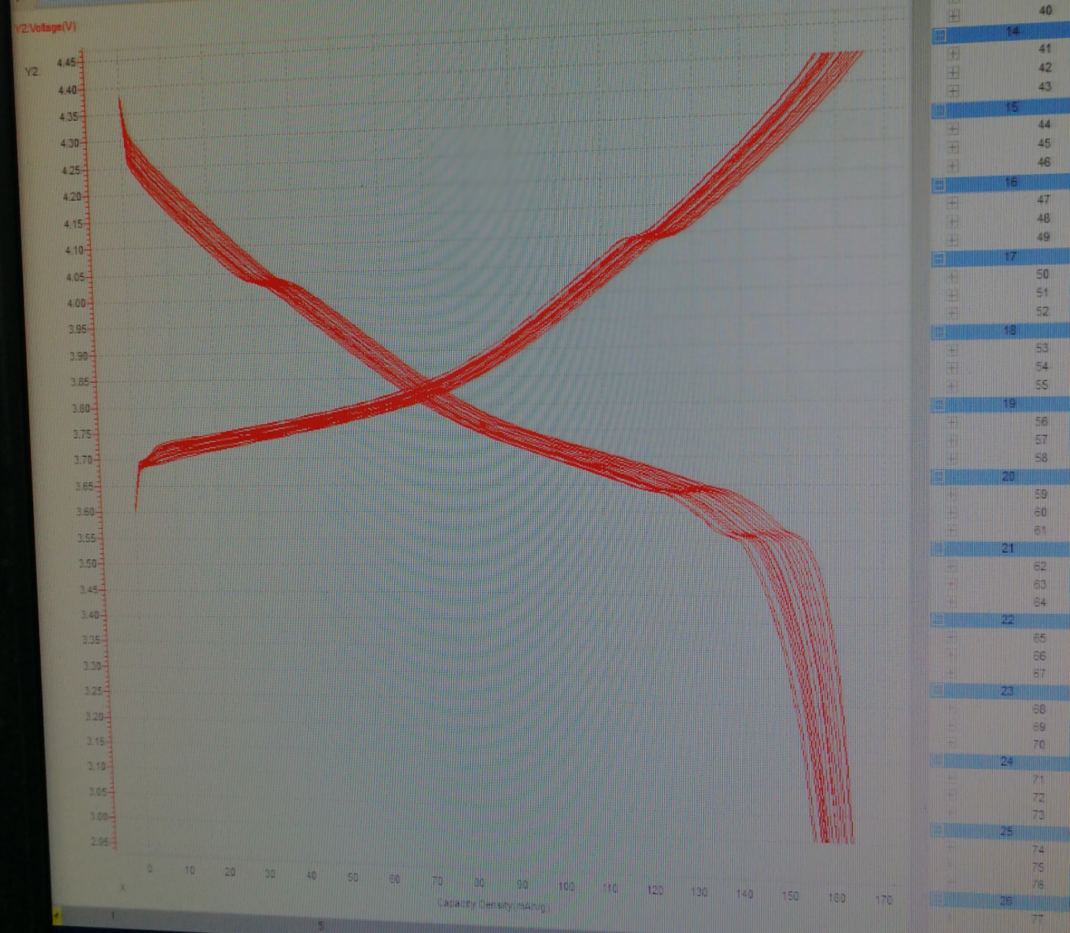
LVP/NCM622=1:9

Slide 19
1.4 Do not Cram too Much

Slide 20
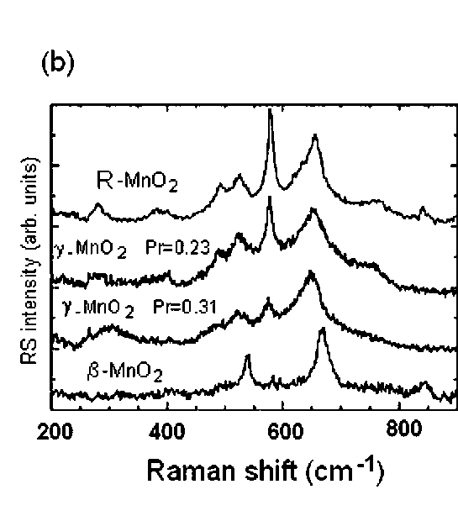
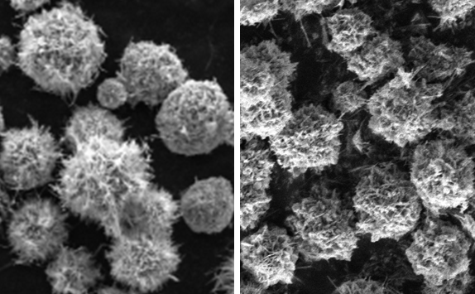
Title Removed
Chem. Rev. 2010, 110, 3, 1278-1319
(slowest, 2h scan)
TGA
Isotherm
XRD
(O2)
Raman
FTIR
SEM
xxh yyh
XX h annealing seems to induce a little higher crystallinity.

Slide 21
1.5 Use Color and Animation

Slide 22
XX Conductivity Study:
No | Composites | Carbon to tungsten ratio(mol) | Conditions: | Thickness (um) | Conductivity(S/cm)
1 | 80wt xx/yy | 3:1 | 1500 degC 2hr | 33.02 | 8.013
2 | 80wt xx/yy | 3:1 | 1500 deg C 4hr | 25.4 | 5.844
3 | 80wt xx/yy | 2:1 | 1500 deg C 2hr | 21.84 | 8.019
4 | 80wt xx/yy | 2:1 | 1400 deg C 2hr | 22.86 | 22.83
5 | 80wt xx/yy | / | Commercial (Alfa) | 25.4 | 12.5

Slide 23
Study the Effect of Precursor Composition in XX Synthesis
Conditions 1: (Batch -1)
Carbon : XX ratio = 3:1 (in mass)
Conditions: 1500 deg C 4 hrs
Conditions 1: (Batch -2)
Carbon : XX ratio = 2:1 (in mass)
Conditions: 1500 deg C 2 hrs
Results(or findings):
New peak showing at xx deg;
Intensity changed at xx;
Mixed xx, yy
Note:
“Carbon” means phenolic resin as the carbon source
“xx” means yy as the Z source

Slide 24
1.6 Be brief (use key words, not long sentences)

Slide 25
Graphite based Filler in Polyethylene
The switching temperatures reported in previous work are mostly between 100-120 ℃.
In our case, LDPE will be melt above 120 ℃. The most graphite materials will perform NTC effect. I also observed in our CNT,AGF and GF samples. If we use the films into the battery and heat up, the temperature will not stop at 120 ℃. The residue energy will still heat up so that the films turn to rearrange conductive network to get relative high conductivity rather than shut down the battery as we expect.
I didn’t use the 0.1 S/cm sample because the high volume fraction can only see the switching temperature at above 120 ℃.
The reported Resistance Ratio for LDPE is 3.5, but in our case it looks higher.
Concern: Using Muffle Oven to measure the low temperature is not accurate.

Slide 26
Study the Effect of Precursor Composition in XX Synthesis
Conditions 1: (Batch -1)
Carbon : XX ratio = 3:1 (in mass)
Conditions: 1500 deg C 4 hrs
Conditions 1: (Batch -2)
Carbon : XX ratio = 2:1 (in mass)
Conditions: 1500 deg C 2 hrs
Results(or findings):
New peak showing at xx deg;
Intensity changed at xx;
Mixed xx, yy
Note:
“Carbon” means phenolic resin as the carbon source
“xx” means yy as the Z source

Slide 27
1.7 Be Clear in Figures (size and label)

Slide 28
1.7 Be Clear in Figures (size and label)
Conditions 1: (Batch -1)
Carbon : tungsten ratio = 3:1 (in mass)
Conditions: 1500 deg C 4 hrs
Conditions 1: (Batch -2)
Carbon : tungsten ratio = 2:1 (in mass)
Conditions: 1500 deg C 2 hrs

Slide 29
1. Preparing A Good Slides: Impression Matters
A Clear/Clean Background
Use Large Font Size (> 24)
Be Organized and Neat
Do not Cram too Much
Use Color and Animation
Be Brief (use key words, not long sentences)
Be Clear in Figures (size and label)
Be Consistent (font, size, color, etc.)
One Slide, One Point

Slide 30
2. Practice Your Talk: Good Practice for Anything
Write your scripts for each of your slides
Practice by yourself
Practice in front of your friends/groupmates
Practice 10 times is better than 2 times

Slide 31
2. Practice Your Talk: Good Practice for Anything
Write your scripts for each of your slides
Practice by yourself
Practice in front of your friends/groupmates
Practice 10 times is better than 2 times

Slide 32
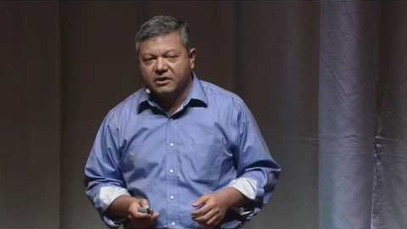
2. Practice Your Talk: Good Practice for Anything
Posture & Body movement
Take note of effective speakers and adopt their successful habits
https://www.youtube.com/watch?v=Q5jEOamZxwo

Slide 33
3. Oral Communication: You Are Talking
Speak Clearly and Loudly Enough
Show Your Energy
Use Your Passion
Eye Contact
You Are “Telling”

Slide 34
3. Oral Communication: You Are Talking
You are “telling”
Keep it simple and focus on a few key points
Repeat key insights
Adjust your content according to the audience

Slide 35
4. Take Questions: The “Dialogue”
Listen to the question carefully
Repeat the question to the entire audience
Handle Q&A like you are doing a formal presentation

Slide 36
Key Tips:
Make a good slides
Practice as much as you can
Present with decent energy
Present like you are telling a fascinated story
Learn skills from effective speakers

Slide 37

Additional reading
https://www.craftofscientificpresentations.com/
Developing the Art of Scientific Presentation: doi.org/10.1016/j.jhsa.2012.09.018
The Art of Selling Science: Presenting an engaging scientific talk: https://blogs.plos.org/blog/2017/01/31/the-art-of-selling-science-presenting-an-engaging-scientific-talk/

Slide 38
Thank you and stay safe!

