Slide 1

What Industry Cares About: Hard & Soft Skills
Tod A Pascal & Zheng Chen
Nanoengineering, UCSD

Slide 2
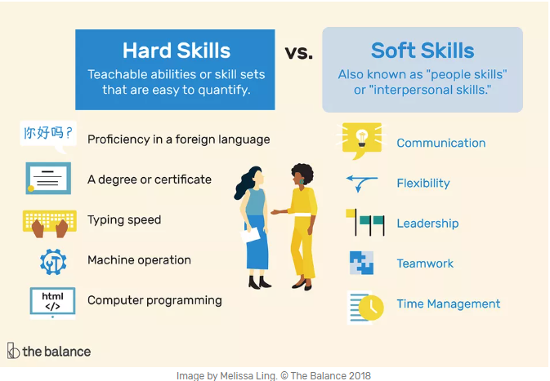

Slide 3

Both are important to Employers!
Hard skills show: I will be great at the job
Soft skills show: I will be a great fit in the company
To get hired: Show the right mix of hard and soft skills, in the right way
We will show you how to emphasize these skills

Slide 4

Soft skills are hard to quantify…
Also know as “people skills”, these are how you relate and interact with your team
It is generally hard to point to evidence that you possesses certain soft skills: while you can point to your grades to show that you can code, how do you prove that you have strong work-ethic in an interview?
While just saying it is not enough, saying it is a good place to start!

Slide 5
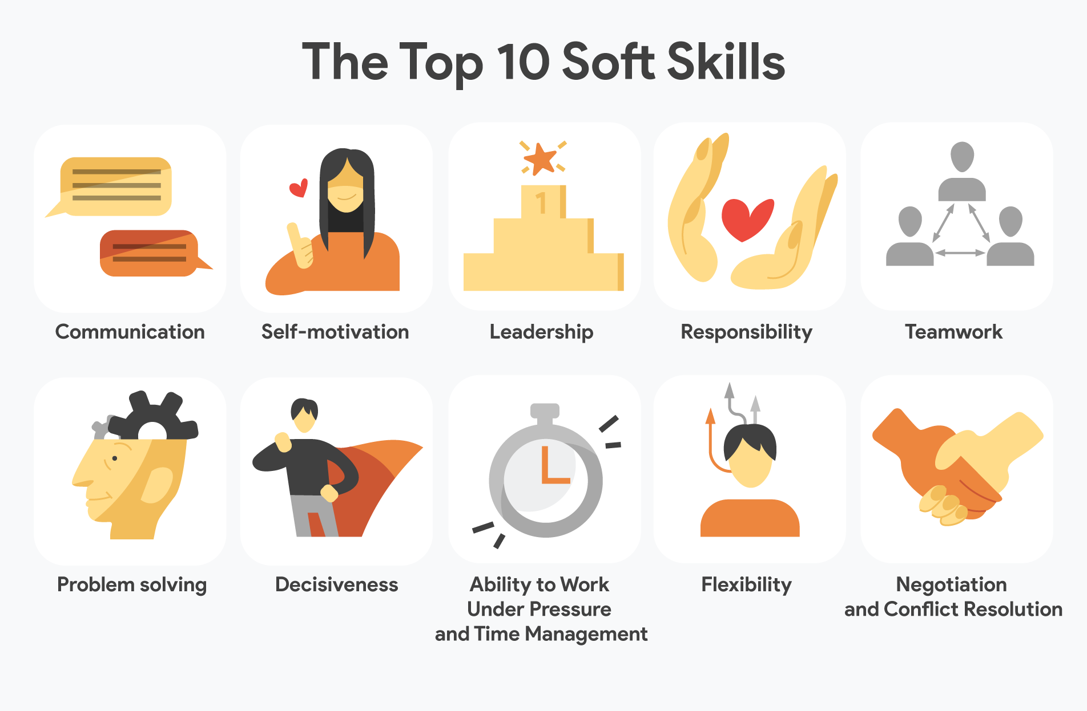

Slide 6
Teamwork: Employers look for team players.
Teamwork is what differentiates good companies from exceptional ones
From a manager’s standpoint, teaming skills consist of two complementary skills: teamwork and team-building
Modern organizations build their teams on the basis of the so-called Belbin Team Roles

Slide 7

Teamwork: Employers look for team players.
There are nine types of roles within effective team:
Completer Finisher
Coordinator
Implementer
Monitor Evaluator
Plant - Thinks outside the box and generates ideas
Resource Investigator
Shaper - Drives the team and makes sure things keep moving forward
Teamworker - Identifies what needs to be done and completes the tasks on behalf of or in cooperation with the other team members
Determine your role and mention it on your CV/during an interview in terms of achievements

Slide 8

Organizational skills
Here are some of the strongest organizational skills to include on your CV
Collaboration
Communication
Delegation
Mental organizational skills
Physical organization
Planning
Prioritizing
Teamwork
Time management
Work-life balance

Slide 9
Organizational skills
Demonstrating during an interview
Common questions asked during interview
Tell me about a time when you were involved in a stressful situation at work and how you handled it.
Tell me about a situation when you succeeded in achieving a goal.
Give me an example of a goal you failed to achieve.

Slide 10
Organizational skills
Demonstrating during an interview
Use the STAR structure
Situation
Task
Action
Result
A good answer consists of all four elements
You describe a situation where you were given a particular task related to the interviewer’s question. Then you explain the actions you undertook to cope with the task and discuss the results of your actions.

Slide 11
Organizational skills
Demonstrating during an interview
“Tell me about a situation when your planning skills and attention to detail made a difference.”
The first situation that comes to mind is on my last project, where we were tasked with developing a novel vaccine delivery system for COVID-19. While various delivery systems were being used, we had no way of determining the efficacy of these approaches. My approach was to develop a python-based database that allows the rapid ranking of every known approach based on pre-defined metrics such as toxicity, cost and material availability. As a result, we were able to identify two promising approaches.

Slide 12

How to include soft skills on your CV
Consider including a “skills” section
Carefully review the job posting to get clues for what to include/emphasize here: review any section called: “desired skills” or “requirements”
If the company has a specific “culture”, emphasize how you would fit in
If the posting emphasizes buzzwords like “teamwork” or “work-life balance”, be sure to include these words in your skills section

Slide 13
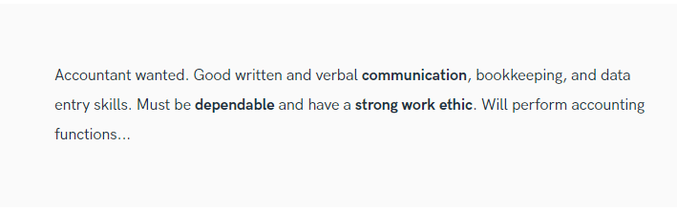

Examples of Soft Skills in a Job Description
Your job is already done!
  List those qualities (if you have them!)
  Offer proof

Slide 14
Examples of Soft Skills in a Job Description
Here is an example of what you might write for this job:
Collaborated and communicated daily with a marketing team of 15 people. Gave monthly progress presentations to the team.
Facilitated team meetings for a project that increased revenue for ecommerce clients 15%.

Slide 15


How to offer proof of your soft skills
Don’t say:
  “I am likable and very funny!”
Do say
  “I led a small team of highly dedicated engineers who developed a new ALD approach. This was my most gratifying moment as a researcher”

Slide 16

Hard Skills
Knowing highly demanded hard skills will put you ahead of the competition.

Slide 17

Reading
Develops You Into A Better Thinker
Stimulates Creativity
Strengthens Analytical Skills
Reduces Stress Levels And Improves Mental Health
Builds Your People-Skills
You will have a lot to read!
(papers, reports, patents, legal documents, etc.)

Slide 18

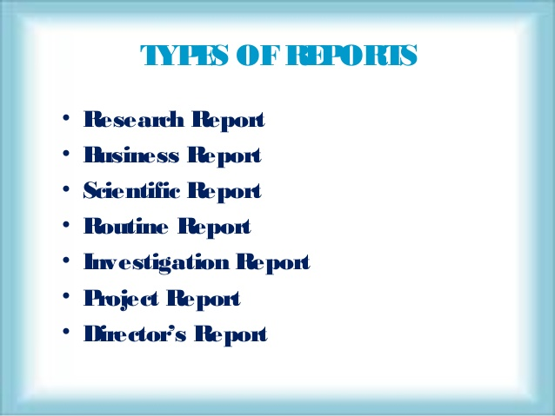
Writing
Nearly all your productivity is shown by writing: it translates to what you have done & achieved.
Good writing helps others learn better about your work.
Paper
Patent
Presentation

Slide 19
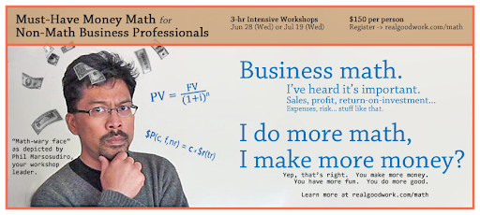

Math
Business and mathematics go hand in hand this is because business deals with money and money encompasses everything in itself.
Commercial organizations use mathematics in accounting, inventory management, marketing, sales forecasting, and financial analysis (marketing, salaries, interest, tax etc.)

Slide 20



Coding
Coding is becoming the most in-demand skills across all industry
IT Industry
Materials Engineering
Coding for Financial Trading

Slide 21
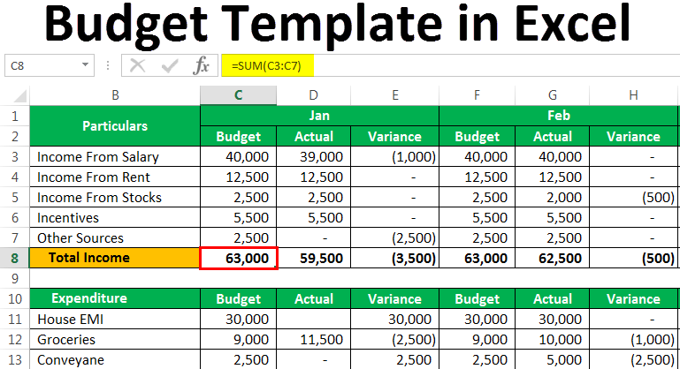
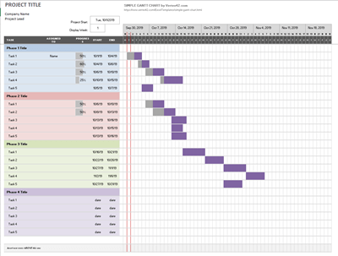
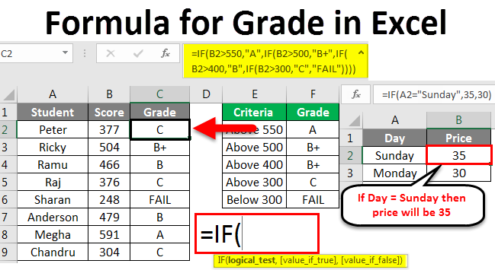
Excel
Excel is still the most popular spreadsheet in business, education, healthcare and personal data organizization.
Project Management

Slide 22
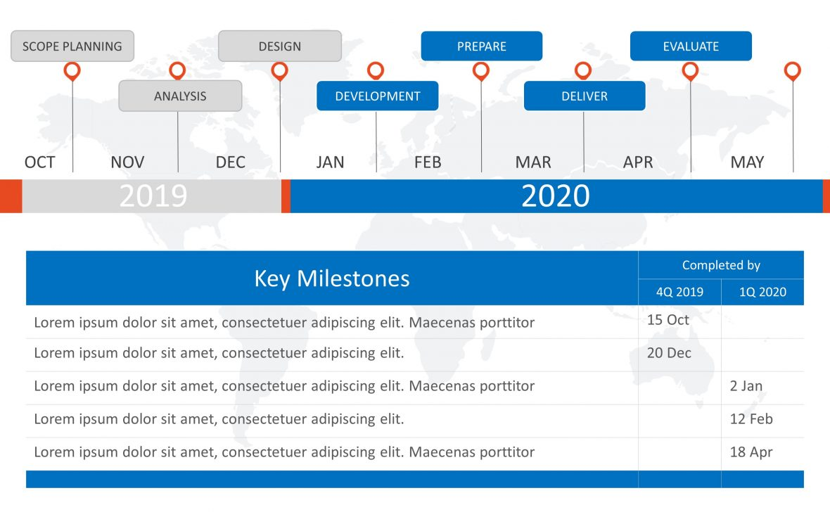
Project Management
It ensures proper expectations are set around what can be delivered;
It helps to monitor progress and control/mitigate risks;
It helps team work

Slide 23
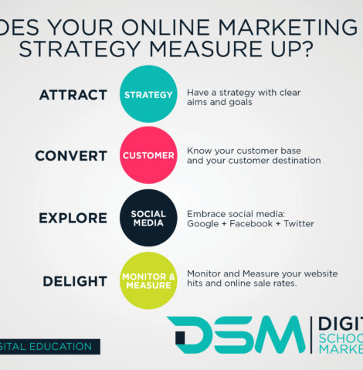
Digital (online) Marketing
Becomes more and more important in modern industry;
Can help interact with targeted audience/customers in real times and more efficiently (create business foundation, attract prospects, nurturing relationships etc..)

Slide 24
Thank you! & Stay Safe!

